Slide 1
CAPTURING REQUIREMENTS
Mehwish Mumtaz

Slide 2
Requirements Engineering
Seven tasks:
Inception
Elicitation
Elaboration
Negotiation
Specification
Validation
Management

Slide 3
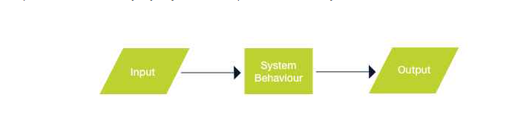
Types of Requirements
Functional Requirement
“Any Requirement Which Specifies What The System Should Do.”
In other words, a functional requirement will describe a particular behavior of function of the system when certain conditions are met, for example: “Send email when a new customer signs up” or “Open a new account”.

Slide 4
Types of Requirements
Non-Functional Requirement
Non-functional requirements: These are basically the quality constraints that the system must satisfy according to the project contract. The priority or extent to which these factors are implemented varies from one project to other. They are also called non-behavioral requirements.

Slide 5
Functional VS Non-Functional Requirement
A functional requirement defines a system or its component. | A non-functional requirement defines the quality attribute of a software system.
It specifies “What should the software system do?” | It places constraints on “How should the software system fulfill the functional requirements?”
Functional requirement is specified by User. | Non-functional requirement is specified by technical peoples e.g. Architect, Technical leaders and software developers.
It is mandatory. | It is not mandatory.
It is captured in use case. | It is captured as a quality attribute.
Defined at a component level. | Applied to a system as a whole.
Helps you verify the functionality of the software. | Helps you to verify the performance of the software.
Functional Testing like System, Integration, End to End, API testing, etc are done. | Non-Functional Testing like Performance, Stress, Usability, Security testing, etc are done.
Usually easy to define. | Usually more difficult to define.
Example1) Authentication of user whenever he/she logs into the system. 2) System shutdown in case of a cyber attack. 3) A Verification email is sent to user whenever he/she registers for the first time on some software system. | Example1) Emails should be sent with a latency of no greater than 12 hours from such an activity. 2) The processing of each request should be done within 10 seconds 3) The site should load in 3 seconds when the number of simultaneous users are > 10000

Slide 6
Characteristics of Requirements
Unambiguous
REQ1 The system shall not accept passwords longer than 15 characters.
The corrected requirement reflects the clarification:
The system shall display an error message if the user enters more than 15 characters.
REQ1 The system shall not accept passwords longer than 15 characters. If the user enters more than 15 characters while choosing the password, an error message shall ask the user to correct it.
Feasible
The requirement should be doable within existing constraints such as time, money, and available resources:
REQ1 The system shall have a natural language interface that will understand commands given in English language.
This requirement may be not feasible within a short span of development time
Testable
Testers should be able to verify whether the requirement is implemented correctly. The test should either pass or fail. To be testable, requirements should be clear, precise, and unambiguous. Some words can make a requirement untestable
Some adjectives: robust, safe, accurate, effective, efficient, expandable, flexible, maintainable, reliable, user-friendly, adequate
Some adverbs and adverbial phrases: quickly, safely, in a timely manner
Nonspecific words or acronyms: etc., and/or, TBD
REQ1 The search facility should allow the user to find a reservation based on Last Name, Date, etc.

Slide 7
Characteristics of Requirements
Consistent
There should not be any conflicts between the requirements. Conflicts may be direct or indirect. Direct conflicts occur when, in the same situation, different behavior is expected:
REQ1 Dates shall be displayed in the mm/dd/yyyy format.
REQ2 Dates shall be displayed in the dd/mm/yyyy format.
Sometimes it is possible to resolve the conflict by analyzing the conditions under which the requirement takes place. For example, if REQ1 was submitted by an American user and REQ2 by a French user, the preceding requirements may be rewritten as follows:
REQ1 For users in the U.S., dates shall be displayed in the mm/dd/yyyy format.
REQ2 For users in France, dates shall be displayed in the dd/mm/yyyy format.
This can eventually lead to the following requirement:
REQ3 Dates shall be displayed based on the format defined in the user’s web browser.

Slide 8
Characteristics of Requirements
Correct
The requirement meets the actual business or system need. An incorrect requirement can still be implemented resulting in a business process or system that does not meet the business needs.
Complete
Each requirement must fully describe the functionality to be delivered. The individual requirement is not missing necessary or relevant information.
Relevant
Traceable
REQ1 The system shall provide the opportunity to book the flight, purchase a ticket, reserve a hotel room, reserve a car, and provide information about attractions.
has a unique ID, it is usually traceable.

Slide 9
Testable Requirements
Testable/Measurable Requirement:
Testable requirements are helpful in making good design
Requirements that are not testable are likely to be ambiguous, incomplete and incorrect

Slide 10
Testable Requirements
Robertson and Robertson suggest 3 ways to help make requirements testable:
Specify a quantitative description for each adverb and adjective
Replace pronouns with specific names of entities
Make sure that every noun is defined in exactly one place in the requirements document

Slide 11
Testable Requirements
Some examples:
Not Testable: Water quality information must be accessible immediately
Testable: Water quality information must be retrieved within five seconds of request
Not Testable: The system should handle a large number of users at a time
Testable: The system should handle 5000 users at a time
Not Testable: User should press the Save button when writing text in the system. This prevents it from being lost.
Testable: User should press the Save button when writing a note in the system. Pressing the Save button prevents the text from being lost.

Slide 12
Requirements Documentation Requirement Definition: Steps Documenting Process
Outline the general purpose and scope of the system, including relevant benefits, objectives, and goals
Describe the background and the rationale behind proposal for new system
Describe the essential characteristics of an acceptable solution
Describe the environment in which the system will operate
Outline a description of the proposal, if the customer has a proposal for solving the problem
List any assumptions we make about how the environment behaves

Slide 13
Requirements Documentation IEEE Standard for SRS Organized by Requirements
Introduction to the Document
1.1 Purpose of the Product
1.2 Scope of the Product
1.3 Acronyms, Abbreviations, Definitions
1.4 References
1.5 Outline of the rest of the SRS
General Description of Product
2.1 Context of Product
2.2 Product Functions
2.3 User Characteristics
2.4 Constraints
2.5 Assumptions and Dependencies
Specific Requirements
3.1 External Interface Requirements
3.1.1 User Interfaces
3.1.2 Hardware Interfaces
3.1.3 Software Interfaces
3.1.4 Communications Interfaces
3.2 Functional Requirements
3.2.1 Requirement 1
3.2.2 Requirement 2
…
3.3 Performance Requirements
3.4 Design Constraints
3.5 Other Quality Requirements
3.6 Other Requirements
Appendices
Functional Requirements for a Spellchecker:
Requirement 1:
System should keep track of words being typed in the existing word processor
Requirement 2:
System should check against each typed word if it is a valid word in the corresponding dictionary
Requirement 3:
System should highlight the wrong words (i.e. which are not part of dictionary) while the user types in the existing word processor.
Requirement 4:
System should give the user an option to make correction in case there is a wrong word typed
Requirement 5:
System should suggest correct words when user opts to make a correction against a wrong word
Non Functional Requirements for a Spellchecker:
Requirement 1:
System should integrate with an existing word processor that runs on Linux.
Requirement 2:
System should use Red color to highlight the wrong words

Slide 14
Requirements Documentation Process Management and Requirements Traceability
Process management is a set of procedures that track
the requirements that define what the system should do
the design modules that are generated from the requirement
the program code that implements the design
the tests that verify the functionality of the system
the documents that describe the system
It provides the threads that tie the system parts together
Numbering the requirements.

Slide 15
Validation and Verification

Slide 16
Validation and Verification
In requirements validation, we check that our requirements definition accurately reflects the customer's needs
In verification, we check that one document or artefact conforms to another e.g code conforms to design .design conforms to SRS.
Verification ensures that we build the system right, whereas validation ensures that we build the right system

Slide 17
Validation and Verification

Slide 18
Validation and Verification Requirements Review for requirement validation
Client representative and our staff examine the SRS document to identify the problems e.g. design team ,testers
Review the stated goals and objectives of the system
Compare the requirements with the goals and objectives
Review the environment in which the system is to operate
Review the information flow and proposed functions
Assess and document the risk, discuss and compare alternatives
Testing the system: how the requirements will be revalidated as the requirements grow and change
E.g who will provide the test data
Which requirements in which phases

Slide 19
Validation and Verification Verification
Check that the requirements-specification document corresponds to the requirements-definition
Make sure that if we implement a system that meets the specification, then the system will satisfy the customer's requirements
Ensure that each requirement in the definition document is traceable to the specification

Slide 20
Measuring Requirements
Measurements focus on three areas
product
process
resources
Number of requirements can give us a sense of the size of the developed system
Number of changes to requirements
Many changes indicate some instability or uncertainty in our understanding of the system

Slide 21
Measuring Requirements Rating Scheme on Scale from 1 to 5
You understand this requirement completely, have designed systems from similar requirements, and have no trouble developing a design from this requirement
Some elements of this requirement are new, but they are not radically different from requirements that have been successfully designed in the past
Some elements of this requirement are very different from requirements in the past, but you understand the requirement and can develop a good design from it
You cannot understand some parts of this requirement, and are not sure that you can develop a good design
You do not understand this requirement at all, and can not develop a design

Slide 22
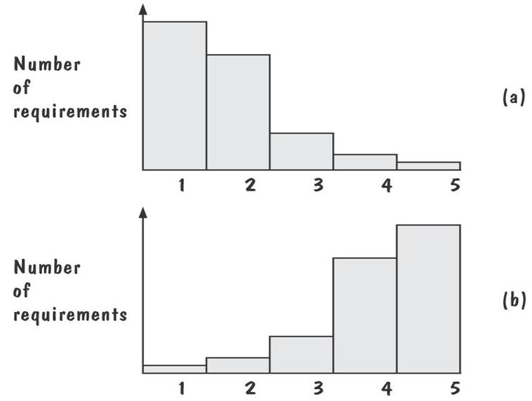
Measuring Requirements: Testers/Designers Profiles
Figure (a) shows profiles with mostly 1s and 2s
The requirements are in good shape
Figure (b) shows profiles with mostly 4s and 5s
The requirements should be revised

Slide 23
Elaboration
Analyze, model, specify…
Some Analysis Techniques
Data Flow Diagrams (DFD)
Use case Diagram
Object Models (ER Diagrams, Abstract class diagrams)
Decision Tables
State Diagrams (Statecharts)
Fence Diagrams
Event Tables
Petri Nets
Event Traces (Message Sequence Charts)
Flow-oriented, Scenario-based, Class-based, Behavioral

Slide 24
Use Case Diagram
Components
A large box: system boundary
Stick figures outside the box: actors, both human and systems
Each oval inside the box: a use case that represents some major required functionality and its variant
A line between an actor and use case: the actor participates in the use case
Use cases do not necessarily model all the tasks, instead they are used to specify user views of essential system behaviour.

Slide 25
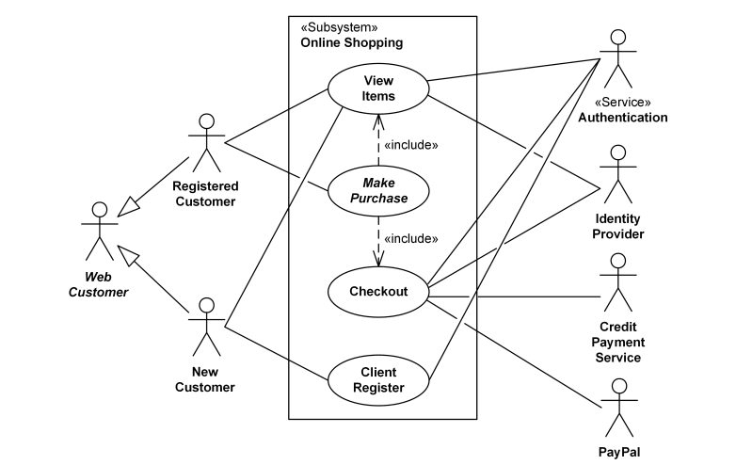
Use Case Diagram

Slide 26
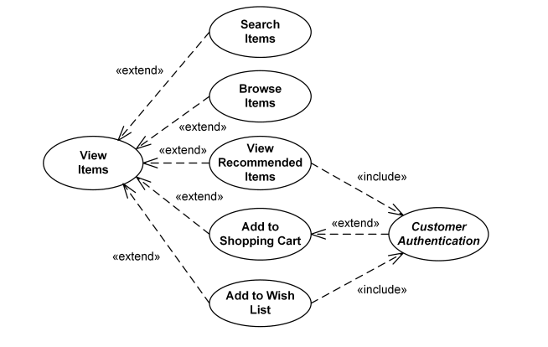
Use Case Diagram

Slide 27
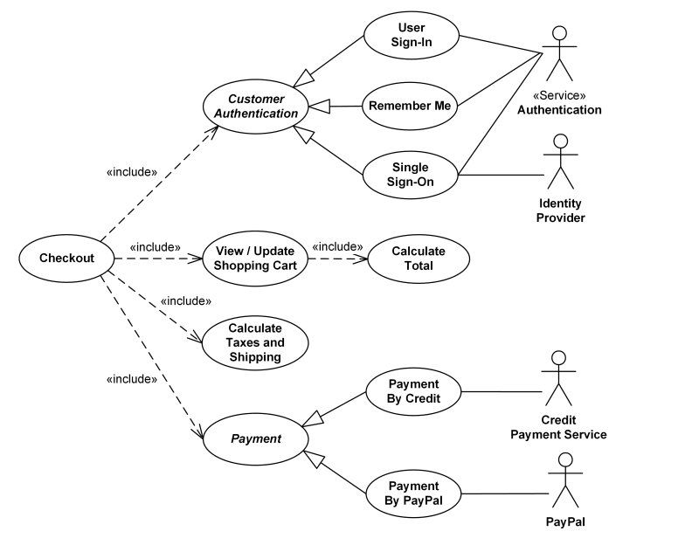
Use Case Diagram

